Slide 1

Semaphores
William M. MongaN

Slide 2
Mutex Locks
Mutex locks with acquire() and release() (a.k.a., “lock” and “unlock,” or “wait” and “signal”) functionality can protect a critical section by providing exclusive access.
These mutex locks can act as shared variables across threads.
But what if we want to allow more than one thread to access a critical section at a time? For example, a hospital waiting room that can seat three people at a time?

Slide 3
Thread Barrier
Block threads until N threads have arrived
struct barrier {
int arrived = 0; int max = 5;
pthread_mutex_lock mutex; // unlocked!
pthread_mutex_lock blocker; // locked!
}

Slide 4
Thread Barrier
Enter() {
lock(mutex);
arrived++;
if(arrived < max)
lock(blocker);
else
unlock(blocker, max – 1);
}

Slide 5
Thread Barrier
Where do we unlock mutex?
Race conditions abound!
Perhaps there is a better way to block on blockers…

Slide 6
Thread Barrier
Block threads until N threads have arrived
struct barrier {
int arrived = 0; int max = 5;
pthread_mutex_lock mutex; // unlocked!
pthread_mutex_lock * blockers; // array
}

Slide 7
Thread Barrier
Enter() {
lock(mutex);
arrived++;
if(arrived < max) {
malloc a new lock X
realloc blockers and add X to the array
lock X to lock
unlock(mutex); // why is this important to be here?
lock X to block
} else {
unlock(blockers, max – 1);
unlock(mutex);
}
}

Slide 8
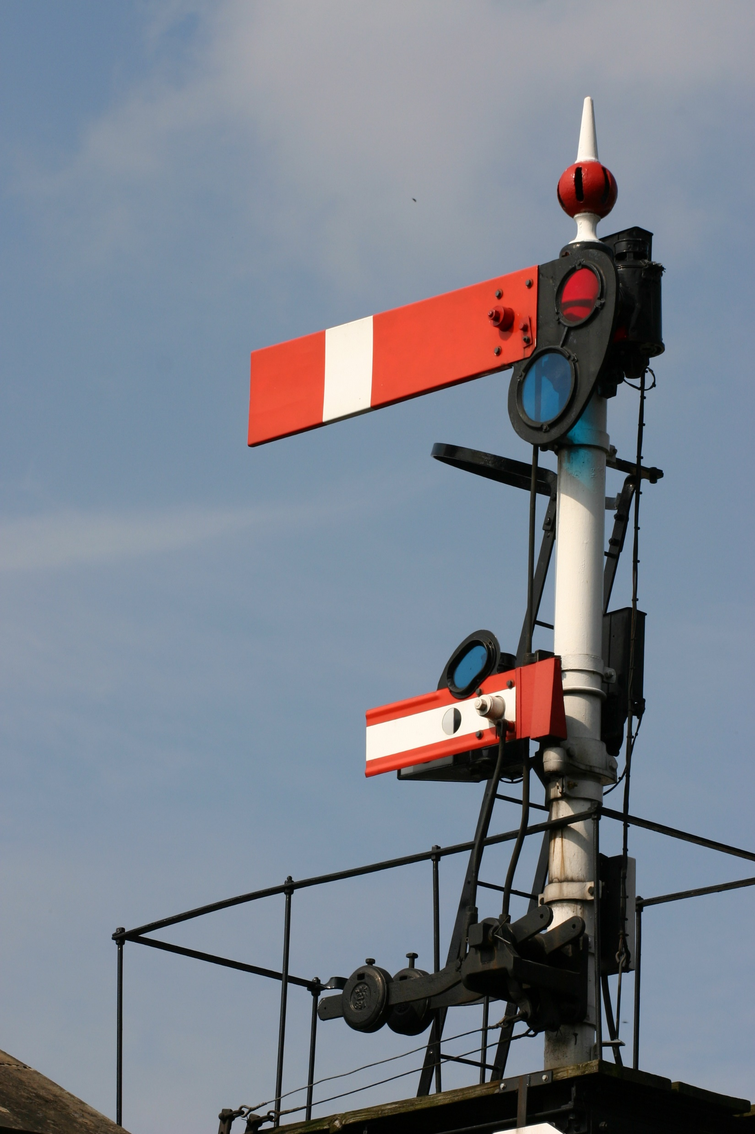
Semaphores
Idea: use the mutex lock to protect an integer counter. If the counter is greater than 0, decrement it and allow the thread to pass. Increment it when the thread has passed the critical section. Otherwise, block until the counter is greater than 0 again.
The “wait” operation is often called “P” and the “signal” operation is often called “V,” from the Dutch words “proberen” (“test”) and “verhogen” (“increment”), coined by Dijkstra.
Exercise: How would you use locks to implement a Semaphore?
The original uploader was AmosWolfe at English Wikipedia., CC BY 2.0 <https://creativecommons.org/licenses/by/2.0>, via Wikimedia Commons

Slide 9
Semaphores
class CountingSemaphore {
volatile int resourceCount
List<Mutex> locks
Mutex mainLock
// Wait operation (P)
void wait() {
mainLock.acquire() // Protect the shared structure
if (resourceCount <= 0) {
resourceCount = resourceCount – 1
Lock lock = new Lock(LOCKED) // Create a new lock that is locked by default
locks.append(lock)
mainLock.release() // Release the main lock before blocking on the resource lock
lock.acquire() // Block if the resource is not available
} else {
mainLock.release()
}
}
// Signal operation (V)
void signal() {
mainLock.acquire()
if (resourceCount < locks.size()) {
Lock lock = locks.pop()
resourceCount = resourceCount + 1
lock.release() // Release one of the resource locks
}
mainLock.release()
}
}
Strong semaphores: the List<Mutex> pops in FIFO order

Slide 10
Semaphore Operations
import java.util.concurrent.Semaphore Semaphore S = new Semaphore( count ); // weak semaphore
S.acquire( n ); // decreases count by n
S.release( n ); // increases count by n or to limit.
S.tryAcquire(); // non blocking acquire, returns true and decreases count if count>0, false otherwise
S.getQueueLength(); // if S is strong

Slide 11
Classic Problems using Semaphores
Producer-Consumer Problem
Database Reader/Writer Problem
The Dining Philosopher’s Problem
The Sleeping Barber Problem
The Roller Coaster Problem
The Santa and Elves Problem

Slide 12
Producer-Consumer Problem
# Initialize semaphore
mutex = Semaphore(1)
empty = Semaphore(N) # N is the size of the buffer
full = Semaphore(0)
def producer():
while True:
item = produce_item()
empty.wait() # Decrease the empty count
mutex.wait() # Enter critical section
put_item_into_buffer(item)
mutex.signal() # Leave critical section
full.signal() # Increase the full count
def consumer():
while True:
full.wait() # Decrease the full count
mutex.wait() # Enter critical section
item = remove_item_from_buffer()
mutex.signal() # Leave critical section
empty.signal() # Increase the empty count
consume_item(item)
Split Semaphore

Slide 13
Database Reader/Writer Problem
# Semaphores and shared data
resource = Semaphore(1) # Controls access to the resource
readCount = 0 # The number of readers currently accessing the resource
readCountAccess = Semaphore(1) # Controls access to readCount
# Writer process
def writer():
while True:
resource.wait() # Request exclusive access to the resource
write_data() # Write data to the resource
resource.signal() # Release exclusive access to the resource
# Reader process
def reader():
while True:
readCountAccess.wait() # Request access to readCount
readCount += 1
if readCount == 1: # If this is the first reader...
resource.wait() # ...request exclusive access to the resource
readCountAccess.signal() # Release access to readCount
read_data() # Read data from the resource
readCountAccess.wait() # Request access to readCount
readCount -= 1
if readCount == 0: # If this is the last reader...
resource.signal() # ...release exclusive access to the resource
readCountAccess.signal() # Release access to readCount

Slide 14
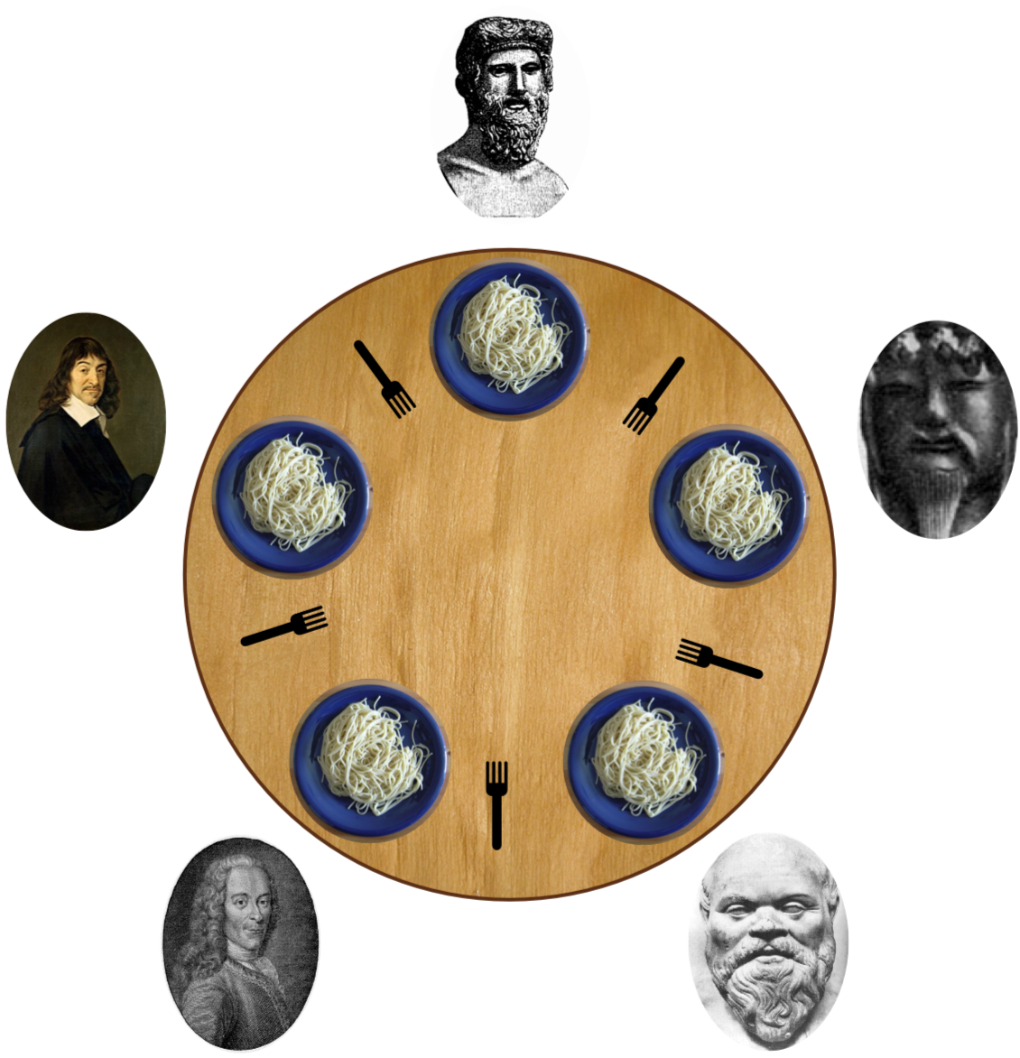
Dining Philosophers Problem
# Initialize semaphores
philosopher = [Semaphore(1) for _ in range(5)] # Assuming 5 philosophers
def philosopher(i):
while True:
think()
philosopher[i].wait() # Grab left fork
philosopher[(i+1) % 5].wait() # Grab right fork
eat()
philosopher[i].signal() # Put down left fork
philosopher[(i+1) % 5].signal() # Put down right fork
Benjamin D. Esham / Wikimedia Commons, CC BY-SA 3.0 <https://creativecommons.org/licenses/by-sa/3.0>, via Wikimedia Commons
This solution is broken! What is wrong with this approach?

Slide 15
Dining Philosophers Problem
# Initialize semaphores
philosopher = [Semaphore(1) for _ in range(5)] # Assuming 5 philosophers
def philosopher(i):
while True:
think()
if i == 0:
philosopher[i].wait() # Grab left fork
philosopher[(i+1) % 5].wait() # Grab right fork
else:
philosopher[(i+1) % 5].wait() # Grab right fork
philosopher[i].wait() # Grab left fork
eat()
philosopher[i].signal() # Put down left fork
philosopher[(i+1) % 5].signal() # Put down right fork
Benjamin D. Esham / Wikimedia Commons, CC BY-SA 3.0 <https://creativecommons.org/licenses/by-sa/3.0>, via Wikimedia Commons
Why does this fix the problem?
Notes:
Resource allocation graph of forks -> philsophers that acquired them, and philosophers -> forks who may want them. A cycle implies the potential for deadlock, and reversing the order of acquisition ensures that cycle never completes.

Slide 16
Dining Philosophers Problem
# Initialize semaphores
mutex = Semaphore(1)
philosopher = [Semaphore(1) for _ in range(5)] # Assuming 5 philosophers
def philosopher(i):
while True:
think()
mutex.wait()
philosopher[i].wait() # Grab left fork
philosopher[(i+1) % 5].wait() # Grab right fork
mutex.signal()
eat()
philosopher[i].signal() # Put down left fork
philosopher[(i+1) % 5].signal() # Put down right fork
Benjamin D. Esham / Wikimedia Commons, CC BY-SA 3.0 <https://creativecommons.org/licenses/by-sa/3.0>, via Wikimedia Commons
How about this? What is the compromise?
Notes:
This ensures that at least one philosopher will eat at a time, but if a philosopher is waiting for a fork, then no other philosophers can acquire forks since the mutex is held while waiting on the fork.

Slide 17
Sleeping Barber Problem
# Initialize semaphore
customers = Semaphore(0)
barber = Semaphore(0)
mutex = Semaphore(1)
def barber():
while True:
customers.wait() # Sleep until a customer is available
mutex.wait()
cutting_hair()
mutex.signal()
barber.signal() # Barber is ready to cut hair
def customer():
mutex.wait()
if there_are_free_seats():
sit_in_waiting_room()
customers.signal() # Wake up the barber if needed
mutex.signal()
barber.wait() # Wait for the barber
get_haircut()
else:
mutex.signal()

Slide 18
The Roller Coaster Problem
# Initialize semaphore
mutex = Semaphore(1)
boarded = Semaphore(0)
unboarded = Semaphore(0)
all_aboard = Semaphore(0)
all_ashore = Semaphore(0)
def passenger():
while True:
mutex.wait()
board()
boarded.signal()
mutex.signal()
all_ashore.wait()
unboard()
unboarded.signal()
def roller_coaster():
while True:
load()
all_aboard.wait() # Wait for all passengers to board
run_roller_coaster()
unload()
all_ashore.signal() # Signal all passengers to unboard
all_ashore.wait() # Wait for all passengers to unboard

Slide 19

The Santa Claus Problem
Source: Youtube

Slide 20
The Santa Claus Problem
# Initialize semaphore
santaSem = Semaphore(0)
reindeerSem = Semaphore(0)
elfTex = Semaphore(1)
mutex = Semaphore(1)
elves = 0
reindeer = 0
def santa():
while True:
santaSem.wait()
mutex.wait()
if reindeer == 9:
prepareSleigh()
reindeerSem.signal(9)
reindeer = 0
elif elves == 3:
helpElves()
mutex.signal()
def reindeer():
mutex.wait()
reindeer += 1
if reindeer == 9:
santaSem.signal()
mutex.signal()
reindeerSem.wait()
getHitched()
def elf():
elfTex.wait()
mutex.wait()
elves += 1
if elves == 3:
santaSem.signal()
else:
elfTex.signal()
mutex.signal()
getHelp()
mutex.wait()
elves -= 1
if elves == 0:
elfTex.signal()
mutex.signal()

